Slide 1
CS4038
DATA MINING
LECTURE # 03
SPRING 2024
FAST – NUCES, CFD CAMPUS
AYESHA LIAQAT
ayesha.liaqat@nu.edu.pk

Slide 2
TODAY’S TOPICS
Data, attributes and types
Types of data and quality

Slide 3
WHAT IS DATA?
Attributes
Collection of data objects and their attributes
An attribute is a property or characteristic of an object
(database columns)
Examples: eye color of a person, temperature, etc.
Attribute is also known as variable, field, characteristic, dimension, or feature
A collection of attributes describe an object (database rows)
Object is also known as record, point, case, sample, entity, or instance
Tid | Refund | Marital Status | Taxable Income | Cheat
1 | Yes | Single | 125K | No
2 | No | Married | 100K | No
3 | No | Single | 70K | No
4 | Yes | Married | 120K | No
5 | No | Divorced | 95K | Yes
6 | No | Married | 60K | No
7 | Yes | Divorced | 220K | No
8 | No | Single | 85K | Yes
9 | No | Married | 75K | No
10 | No | Single | 90K | Yes
Objects
10

Slide 4
ATTRIBUTE VALUES
Attribute values are numbers or symbols assigned to an attribute for a particular object
Distinction between attributes and attribute values
Same attribute can be mapped to different attribute values
Example: height can be measured in feet or meters
Different attributes can be mapped to the same set of values
Example: Attribute values for ID and age are integers
But properties of attribute can be different than the properties of the values used to represent the attribute
Example: ID has no limit, but age has a maximum and minimum value

Slide 5
ATTRIBUTES TYPES
Nominal
Binary
Ordinal
Numeric: quantitative
Interval-scaled
Ratio-scaled

Slide 6
ATTRIBUTES TYPES
Nominal: categories, states, or “names of things”. No meaningful order
Hair_color = {auburn, black, blond, brown, grey, red, white}
marital status, occupation, ID numbers, zip codes
Also known as categorical or qualitative data
Categories as numbers but mathematical operations are not meaningful
Binary: nominal attribute with only 2 states (0 and 1)[Boolean]
Symmetric binary: both outcomes equally important
e.g., gender
Asymmetric binary: outcomes not equally important.
e.g., medical test (positive vs. negative)
Convention: assign 1 to most important outcome (e.g., HIV positive)
Ordinal: values have a meaningful order (ranking) but magnitude between successive values is not known.
Size = {small, medium, large}, grades, army rankings
Notes:
These 3 are Qualitative

Slide 7
NUMERIC ATTRIBUTE TYPES
Measurable Quantity (integer or real-valued)
Numeric attributes can be discrete or continuous values
Interval
Measured on a scale of equal-sized units
Values have order and can be positive, 0 , negative
E.g., temperature in C˚or F˚, calendar dates
No true zero-point
Ratio
Inherent zero-point
We can speak of values as being an order of magnitude larger than the unit of measurement (10 K˚ is twice as high as 5 K˚).
e.g., temperature in Kelvin, length, counts, monetary quantities, years of experience,height,weight

Slide 8
PROPERTIES OF ATTRIBUTE VALUES
The type of an attribute depends on which of the following properties/operations it possesses:
Distinctness: = ≠
Order: < >
Differences are + -
meaningful:
Ratios are meaningful:
* /
Nominal attribute: distinctness
Ordinal attribute: distinctness & order
Interval attribute: distinctness, order & meaningful differences
Ratio attribute: all 4 properties/operations

Slide 9
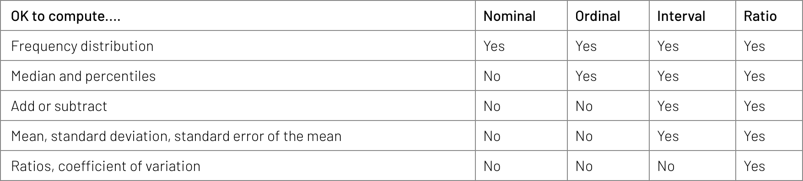
PROPERTIES OF ATTRIBUTE VALUES
https://www.graphpad.com/support/faq/what-is-the-difference-between-ordinal-interval-and-ratio-variables-why-should-i-care/

Slide 10
Attribute Type | Description | Examples | Operations
Nominal | Nominal attribute values only distinguish. (=, ≠) | zip codes, employee ID numbers, eye color, sex: {male, female} | mode, entropy, contingency correlation, χ2 test
Ordinal | Ordinal attribute values also order objects. (<, >) | hardness of minerals, {good, better, best}, grades, street numbers | median, percentiles, rank correlation, run tests, sign tests
Interval | For interval attributes, differences between values are meaningful. (+, - ) | calendar dates, temperature in Celsius or Fahrenheit | mean, standard deviation, Pearson's correlation, t and F tests
Ratio | For ratio variables, both differences and ratios are meaningful. (*, /) | temperature in Kelvin, monetary quantities, counts, age, mass, length, current | geometric mean, harmonic mean, percent variation
Categorical Qualitative
Numeric Quantitative
This categorization of attributes is due to S. S. Stevens

Slide 11
Attribute Type | Transformation | Comments
Nominal | Any permutation of values | If all employee ID numbers were reassigned, would it make any difference?
Ordinal | An order preserving change of values, i.e., new_value = f(old_value) where f is a monotonic function | An attribute encompassing the notion of good, better best can be represented equally well by the values {1, 2, 3} or by { 0.5, 1, 10}.
Interval | new_value = a * old_value + b where a and b are constants | Thus, the Fahrenheit and Celsius temperature scales differ in terms of where their zero value is and the size of a unit (degree).
Ratio | new_value = a * old_value | Length can be measured in meters or feet.
Categorical Qualitative
Numeric Quantitative
This categorization of attributes is due to S. S. Stevens

Slide 12
DISCRETE VS. CONTINUOUS ATTRIBUTES
Discrete Attribute
Has only a finite or countably infinite set of values
E.g., zip codes, profession, or the set of words in a collection of documents
Sometimes, represented as integer variables
Note: Binary attributes are a special case of discrete attributes
Continuous Attribute
Has real numbers as attribute values
E.g., temperature, height, or weight
Practically, real values can only be measured and represented using a finite number of digits
Continuous attributes are typically represented as floating-point variables

Slide 13
CRITIQUES OF THE ATTRIBUTE CATEGORIZATION
Incomplete
Asymmetric binary
Cyclical
Multivariate
Partially ordered
Partial membership
Relationships between the data
Real data is approximate and noisy
This can complicate recognition of the proper attribute type
Treating one attribute type as another may be approximately correct

Slide 14
TYPES OF DATA SETS

Slide 15
IMPORTANT CHARACTERISTICS OF DATA SETS
Dimensionality (number of attributes)
High dimensional data brings a number of challenges (a.k.a curse of dimensionality)
Dimensionality reduction is the solution for very large no. of attributes
Sparsity
Only presence counts
Resolution
Patterns depend on the scale e.g… surface of earth at different resolution scales
Size
Type of analysis may depend on size of data

Slide 16
TYPES OF DATA SETS
Record
Data Matrix
Document Data
Transaction Data
Graph
World Wide Web
Molecular Structures
Ordered
Spatial Data
Temporal Data
Sequential Data
Genetic Sequence Data

Slide 17
RECORD DATA
Tid | Refund | Marital Status | Taxable Income | Cheat
1 | Yes | Single | 125K | No
2 | No | Married | 100K | No
3 | No | Single | 70K | No
4 | Yes | Married | 120K | No
5 | No | Divorced | 95K | Yes
6 | No | Married | 60K | No
7 | Yes | Divorced | 220K | No
8 | No | Single | 85K | Yes
9 | No | Married | 75K | No
10 | No | Single | 90K | Yes
Data that consists of a collection of records, each of which consists of a fixed set of attributes
10

Slide 18
DATA MATRIX
If data objects have the same fixed set of numeric attributes, then the data objects can be thought of as points in a multi-dimensional space, where each dimension represents a distinct attribute
Such a data set can be represented by an m by n matrix, where there are m rows, one for each object, and n columns, one for each attribute
Projection of x Load | Projection of y load | Distance | Load | Thickness
10.23 | 5.27 | 15.22 | 2.7 | 1.2
12.65 | 6.25 | 16.22 | 2.2 | 1.1

Slide 19
DOCUMENT DATA
Each document becomes a ‘term’ vector
Each term is a component (attribute) of the vector
The value of each component is the number of times the corresponding term occurs in the document.
 | team | coach | play | ball | score | game | win | lost | timeout | season
Document 1 | 3 | 0 | 5 | 0 | 2 | 6 | 0 | 2 | 0 | 2
Document 2 | 0 | 7 | 0 | 2 | 1 | 0 | 0 | 3 | 0 | 0
Document 3 | 0 | 1 | 0 | 0 | 1 | 2 | 2 | 0 | 3 | 0

Slide 20
TRANSACTION DATA
A special type of data, wherein:
Each transaction involves a set of items.
For example, consider a grocery store. The set of products purchased by a customer during one shopping trip constitute a transaction, while the individual products that were purchased are the items.
TID | Items
1 | Bread, Coke, Milk
2 | Beer, Bread
3 | Beer, Coke, Diaper, Milk
4 | Beer, Bread, Diaper, Milk
5 | Coke, Diaper, Milk

Slide 21
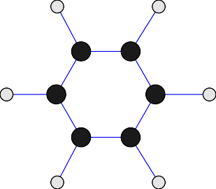
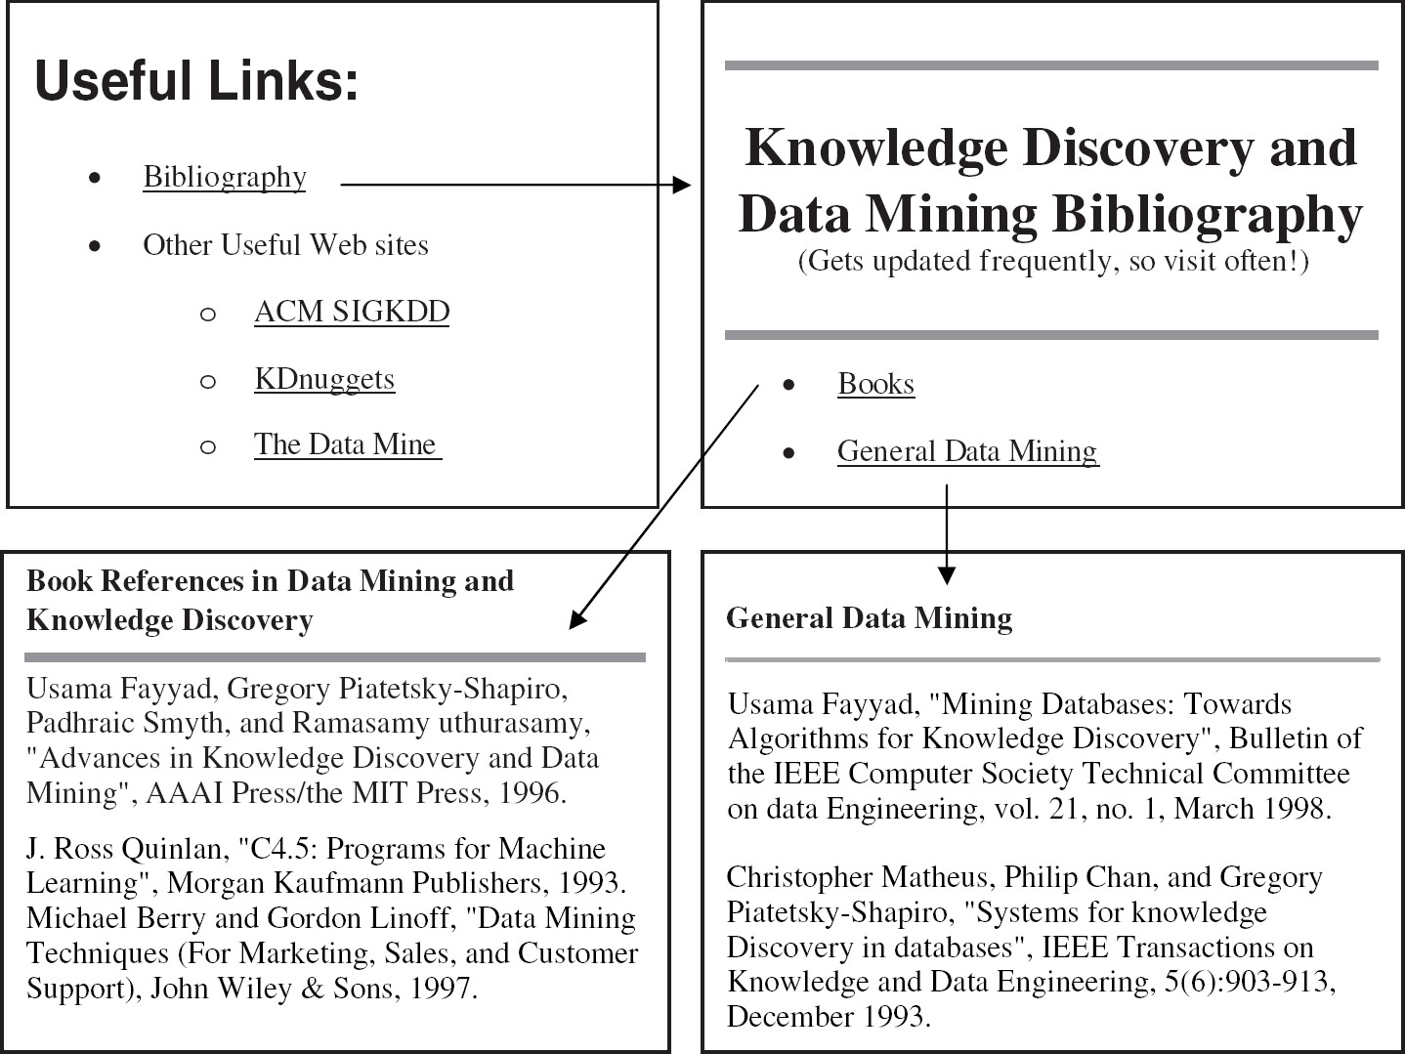
GRAPH DATA
Examples: Generic graph, a molecule, and webpages
2
5
1
2
5
Benzene Molecule: C6H6

Slide 22
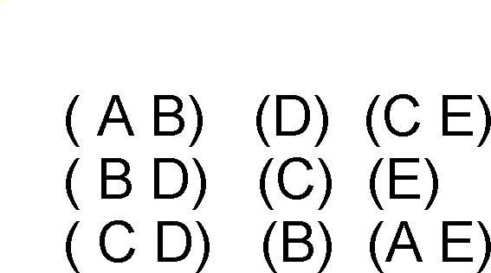
ORDERED DATA
Items/Events
Sequences of transactions
An element of the sequence

Slide 23
ORDERED DATA
GGTTCCGCCTTCAGCCCCGCGCC CGCAGGGCCCGCCCCGCGCCGTC GAGAAGGGCCCGCCTGGCGGGCG GGGGGAGGCGGGGCCGCCCGAGC CCAACCGAGTCCGACCAGGTGCC CCCTCTGCTCGGCCTAGACCTGA GCTCATTAGGCGGCAGCGGACAG GCCAAGTAGAACACGCGAAGCGC TGGGCTGCCTGCTGCGACCAGGG
Genomic sequence data

Slide 24
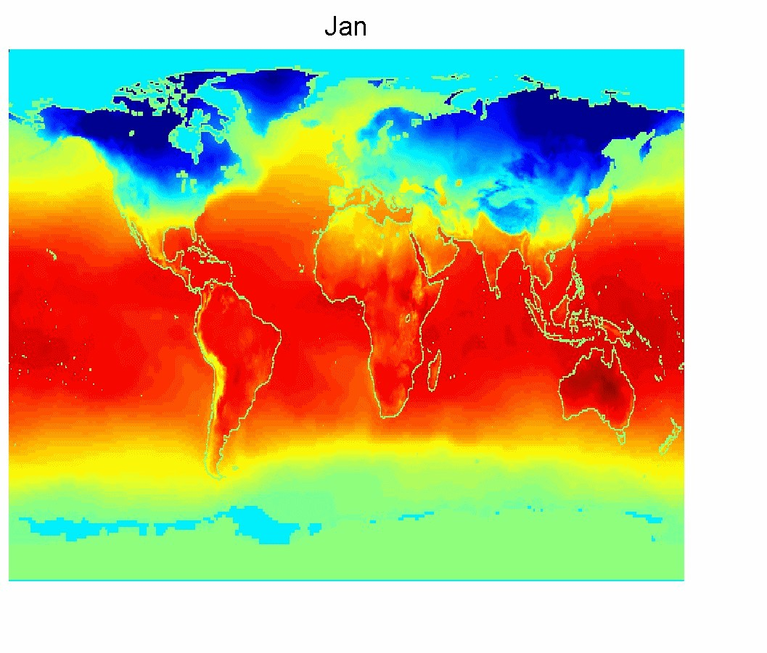
ORDERED DATA
Spatio-Temporal Data
Average Monthly Temperature of land and ocean

Slide 25
AND MANY OTHER TYPES…
Image data
Sound waves data
Time series data
…

Slide 26
READING MATERIAL
Chapter 2:Tan, Steinbach & Kumar
Chapter 2: Han, Kamber & Pei
Related articles:
https://spatialanalysisonline.com/HTML/attributes.htm
https://www.formpl.us/blog/nominal-ordinal-interval-ratio-variable-example

